Slide 1
Pipelined Variable IIR Filter
Paul Nieves

Slide 2
Table of contents
01
02
03
04
Problem Statement
Design Setup
IIR Architectures
Results and Conclusion

Slide 3
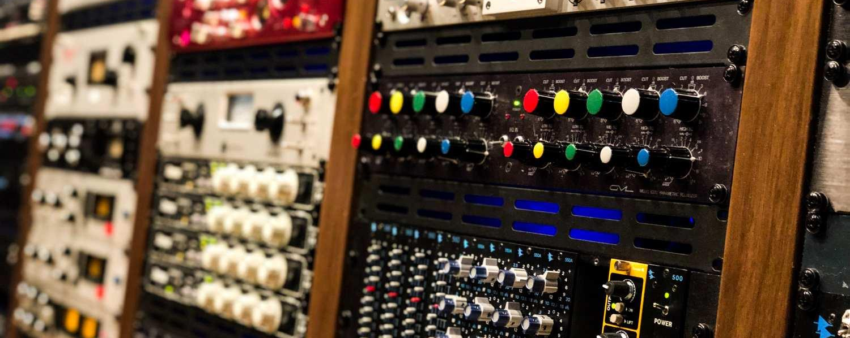
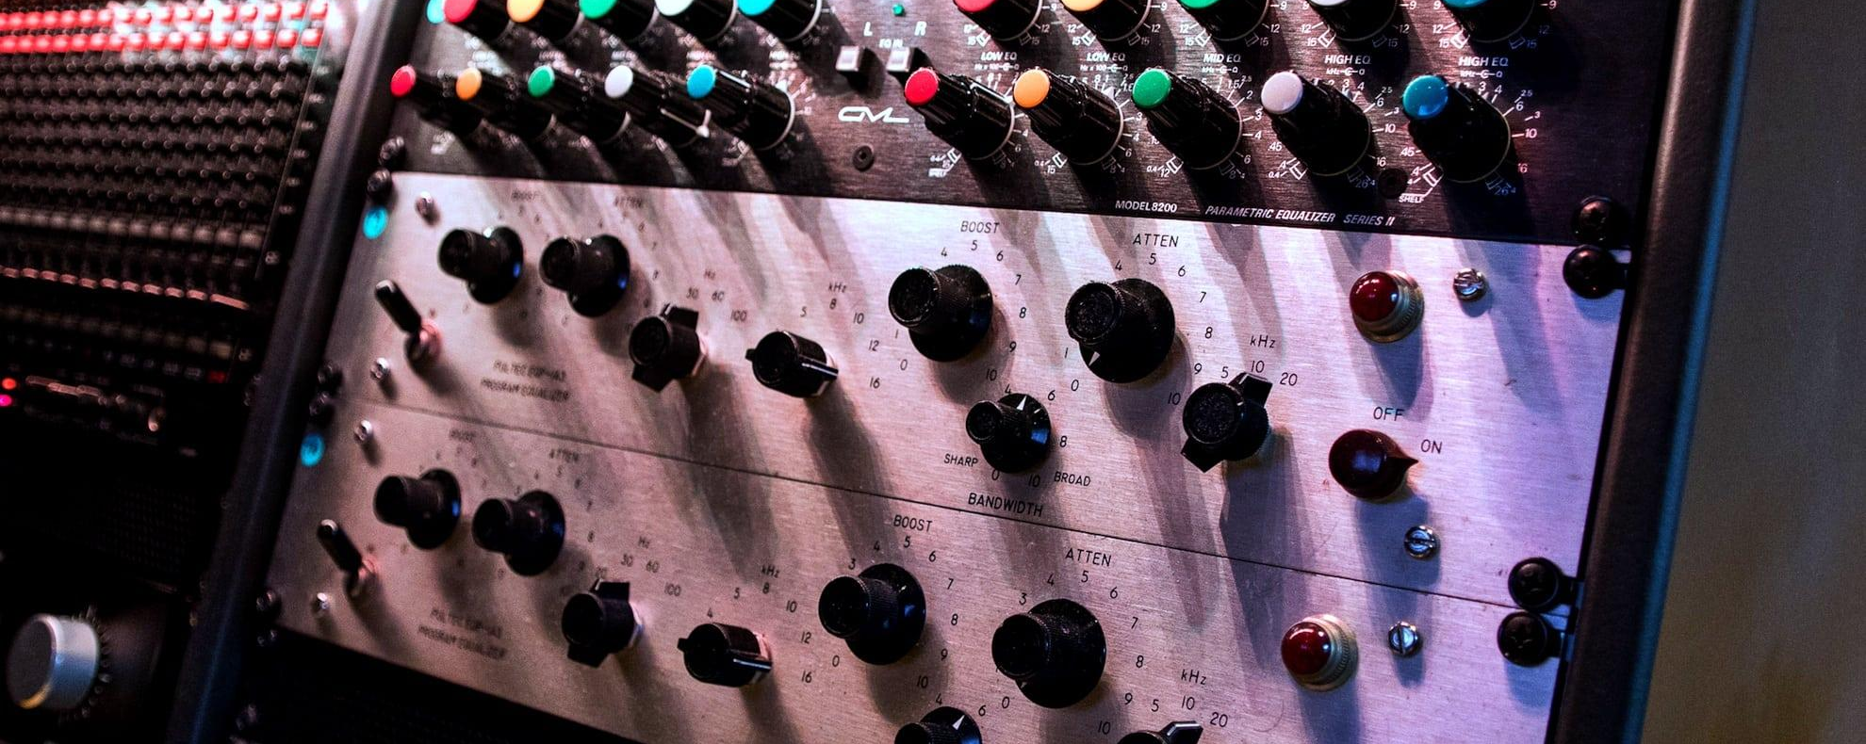
01
Problem Statement

Slide 4
Problem Statement
Objective:
Implement a digital equalizer (EQ) that processes audio signals in real time by using a pipelined IIR filter.
Challenges:
Precision & Resource Management
Low Latency Processing
Dynamic Filter Response
Pipelining Feedback and Feed-Forward Paths

Slide 5
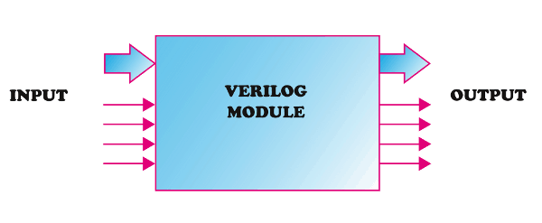
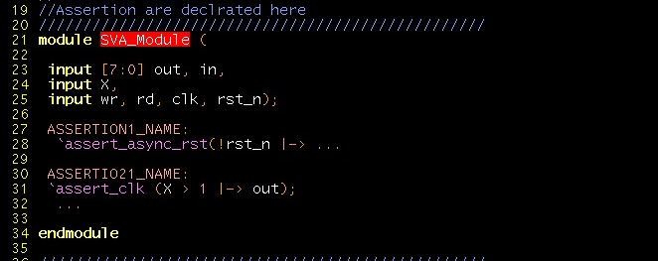
02
Design Setup

Slide 6
Design Setup
Testbench Structure (FIR_Filter_tb)
Modules:
Iir_filter_pipelined
Coeff_selector
SineWave
Counter
Octave Code
Generate test vector
Makes test data in binary
Generate Coefficients
Makes SystemVerilog 3D array initialization for Coefs

Slide 7
Coeff_selector Module
Important Signals:
filter_index (input), B (output), A (output)
Important Variables:
mem (3D array)
Dimensions: [NUM_LP_FILTERS][2][FF_TAP_COUNT]
First Dimension: Filter index (0 to 19).
Second Dimension: Coefficient type (0 for B taps, 1 for A taps).
Third Dimension: Tap index within each filter.
Notes:
filter_index (input): A 9-bit signal used to select one of the 20 filters.
B (output): An array of 4 feed-forward coefficients extracted from the memory.
A (output): An array of 3 feedback coefficients (first three taps from the memory).

Slide 8
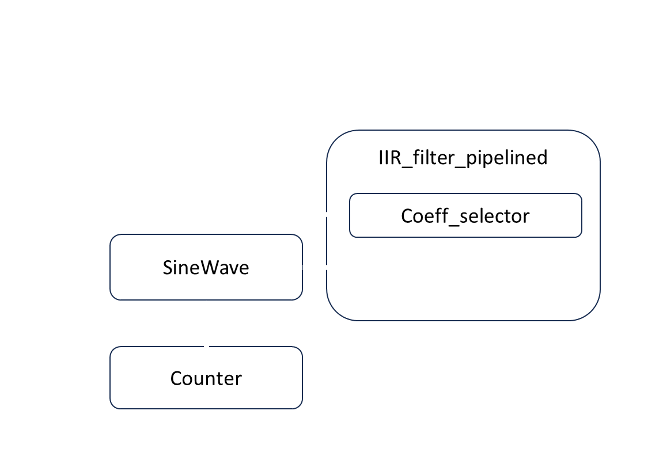
Design Setup

Slide 9
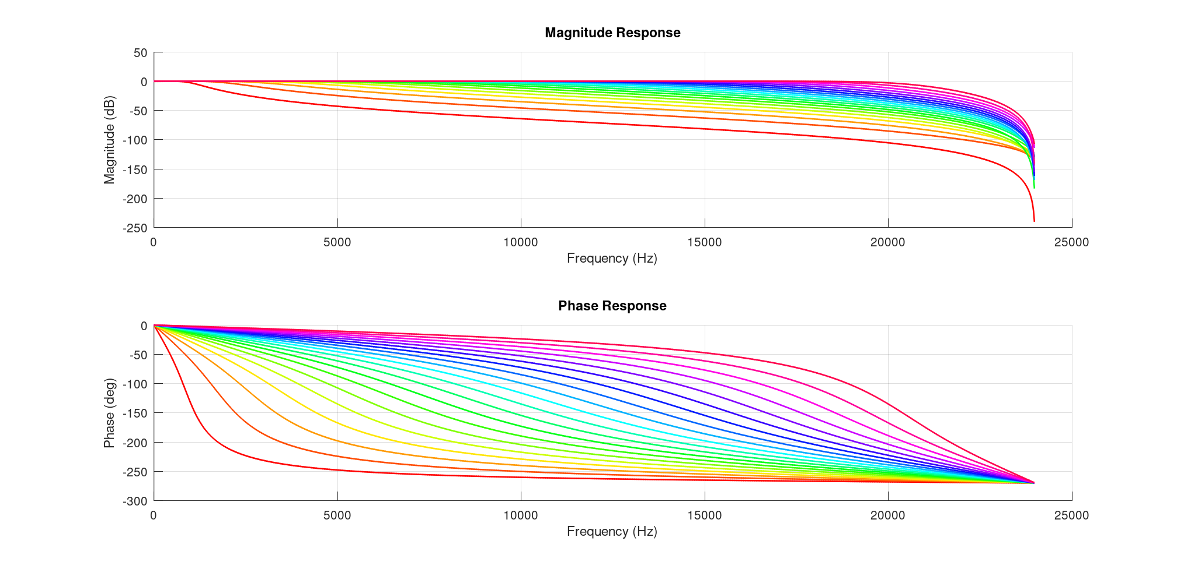
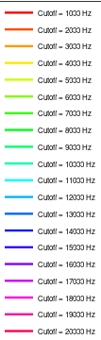
Design Setup

Slide 10
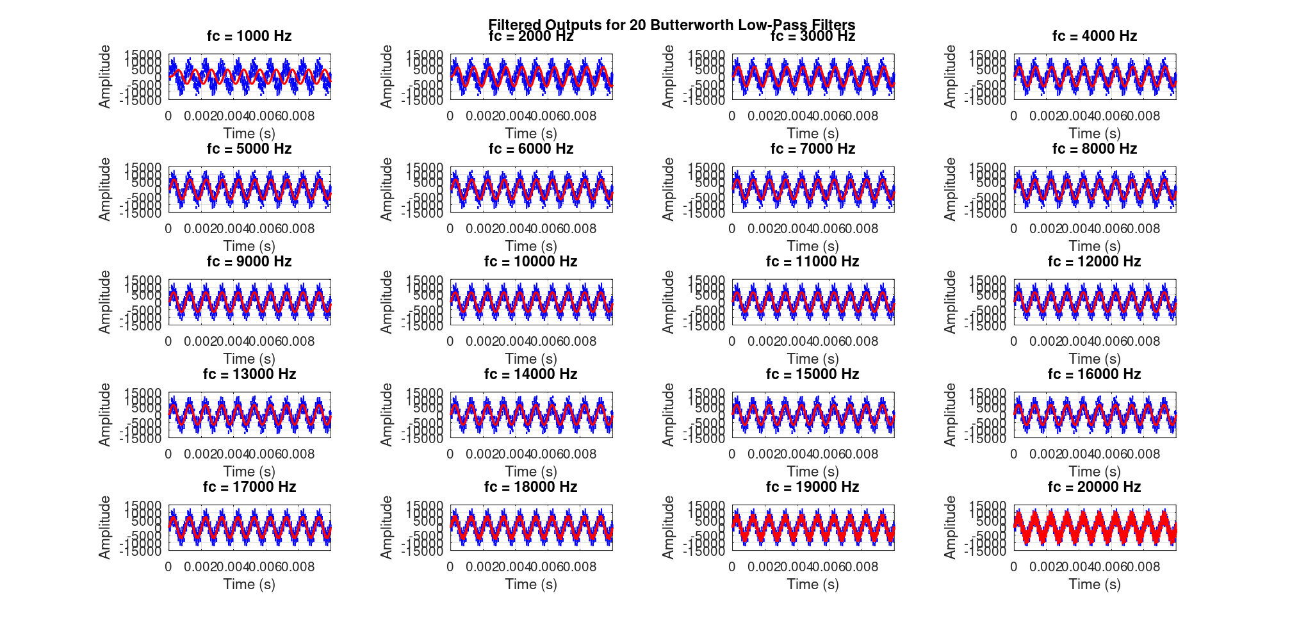
Design Setup

Slide 11
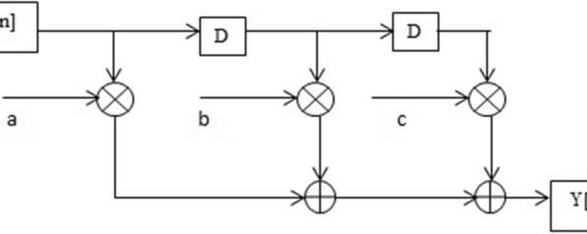
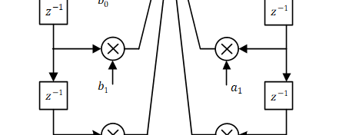
03
IIR Arch

Slide 12


IIR Architectures
Trad. IIR
Piped IIR

Slide 13
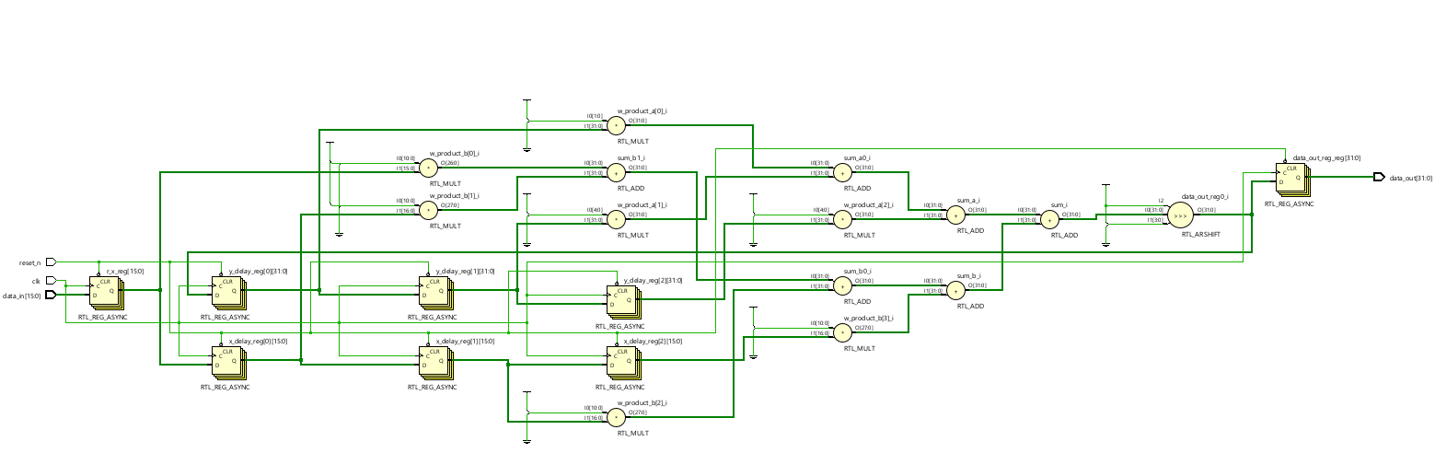
IIR Architectures
Trad. IIR

Slide 14
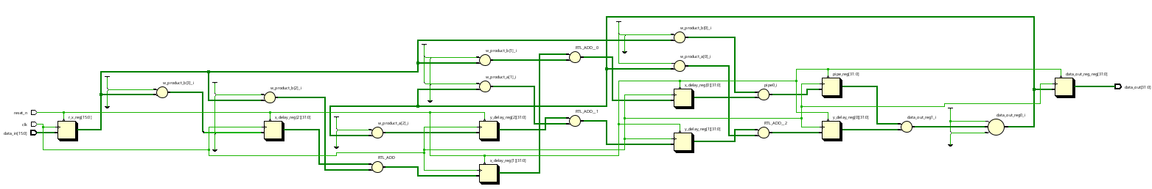
IIR Architectures
Piped IIR

Slide 15
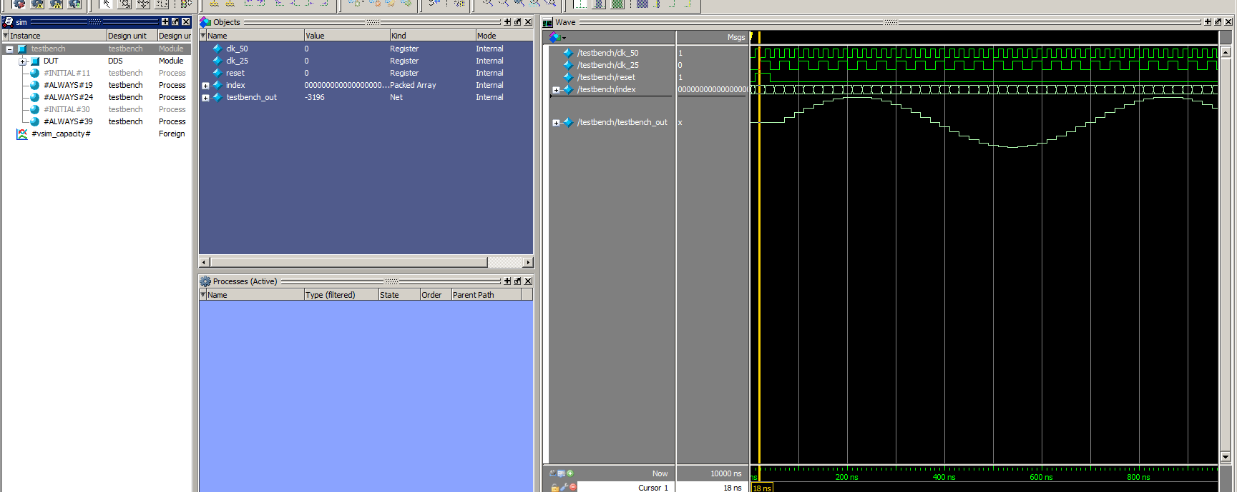
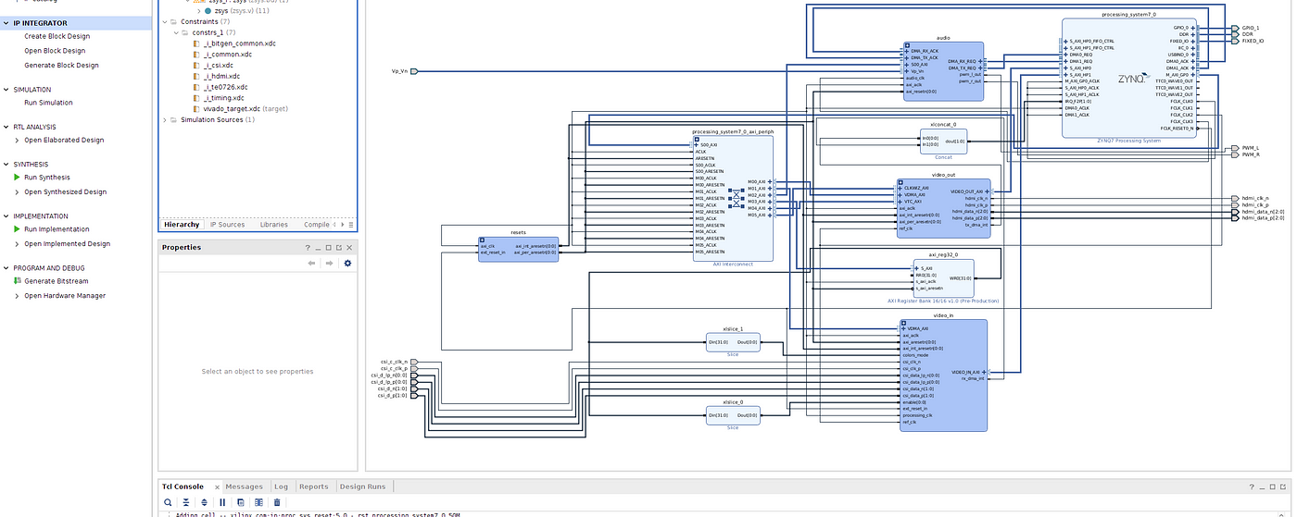
04
Results

Slide 16
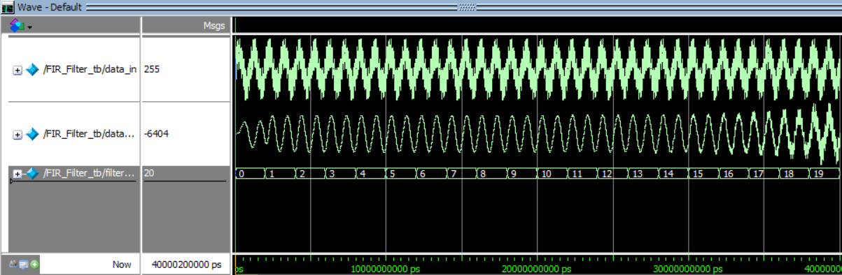
Model Sim
Trad. IIR

Slide 17
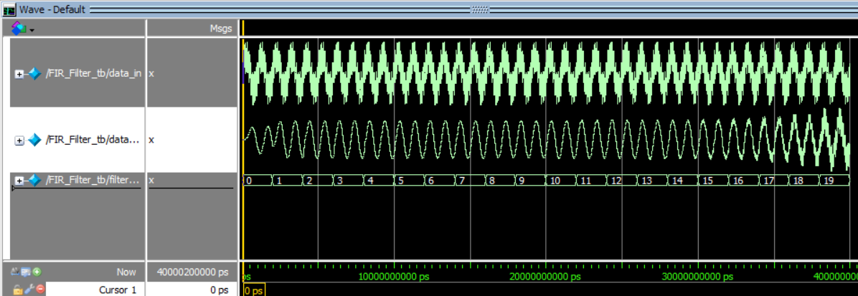
Model Sim
Piped IIR

Slide 18
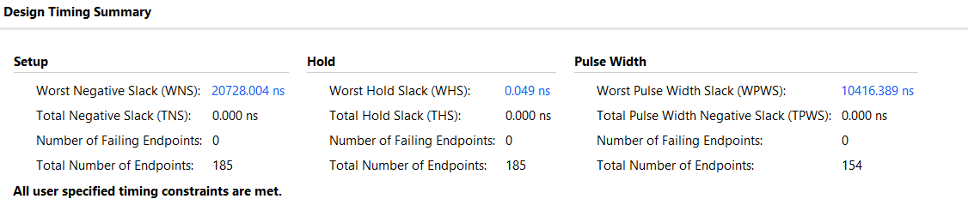
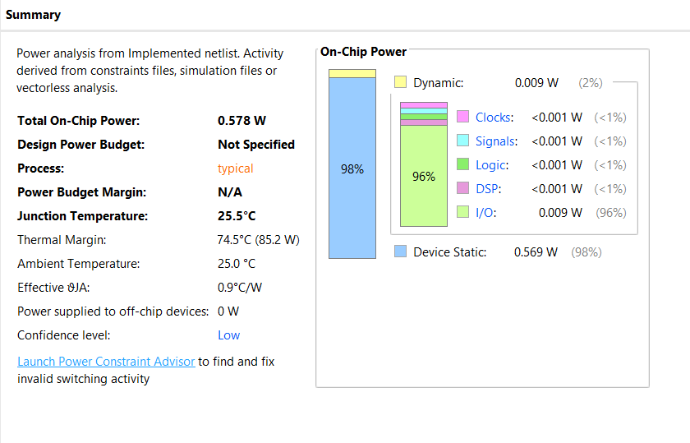
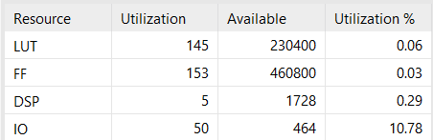
Area, Power, and Timing
Trad. IIR

Slide 19
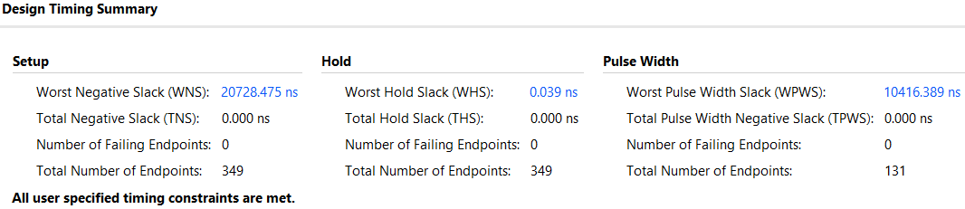
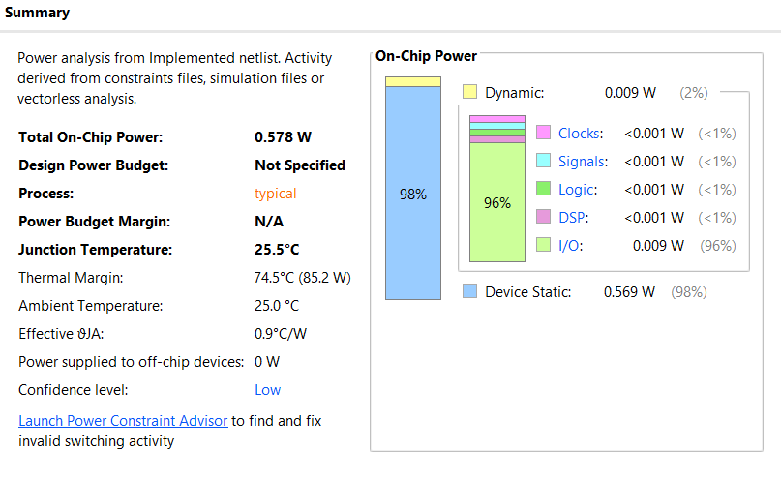
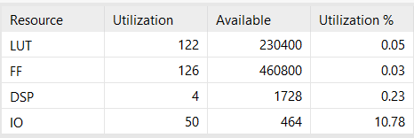
Area, Power, and Timing
Piped IIR

Slide 20
Area, Power, and Timing
SDC Report
Metric | Original IIR Filter | Pipelined IIR Filter | Improvement
Dynamic Power | 7.567 µW | 852.387 nW | ~89% reduction
Leakage Power | 20.893 µW | 18.183 µW | ~13% reduction
Total Cell Area | 2698.48 units | 2140.48 units | ~20% reduction
Combinational Area | 1376.93 units | 953.15 units | ~31% reduction
Number of Cells | 672 | 564 | ~16% reduction
Buf/Inv Count | 238 | 147 | ~38% reduction

Slide 21
Conclusion
Real-time IIR EQ achieved with pipelining
Reduced the critical path delay
2(Ta)+Tm
Reduced Power Consumption
Dynamic power ↓89% (7.57µW→852nW)
Leakage power ↓13% (20.89µW→18.18µW)

Slide 22
Thanks!
Any questions?
nievep@rpi.edu
paulnieves.com

